Slide 1
SEN Policy and Information Report 2023-2024
Prepared by Miss Gaffer | Approved by Governing body: July 2023 | Review date: October 2024

Slide 2
Aims
To provide every opportunity for all of the pupils with Special Educational Needs within our school to achieve their potential.
To raise the aspirations and expectations for all pupils with Special Educational Needs within the school.
To take a personalised approach to learning, recognising that every individual has different needs and needs differing support to reach their potential.
To ensure that all pupils with SEND are fully integrated in to the life of the school and take a full part in all activities and have an equal opportunity to represent the school in positions of responsibility within school and the wider community.
We believe education is a partnership between the child, guardians and teacher so the views, thoughts and wishes of children and families will be actively sought and the planning and implementation of their support plan will be achieved collaboratively.
Our provision will be underpinned by quality first teaching, planned and delivered by the class teacher, supported by teaching assistants in class and include targeted intervention support or external support and advice when required.
Legislation and guidance
All schools:
This policy and information report is based on the statutory Special Educational Needs and Disability (SEND) Code of Practice and the following legislation:
- Part 3 of the Children and Families Act 2014, which sets out schools’ responsibilities for pupils with SEN and disabilities
- The Special Educational Needs and Disability Regulations 2014, which set out schools’ responsibilities for education, health and care (EHC) plans, SEN co-ordinators (SENCOs) and the SEN information report
This policy also complies with our funding agreement and articles of association.

Slide 3
SEN information Report 2022 - 2023
Who can I contact?
Kinds of SEN
Approaches to teaching pupils with SEN
Matching the Curriculum to pupil’s needs
Inclusivity
Supporting emotional and social development
Family support worker
Assessing progress and support
In partnership with others
Transition
Involving parents
Effectiveness of Provision
Expressing any concerns
Suffolk Local Offer

Slide 4
Who can I contact for information?
Your child’s class teacher is the first point of contact for any initial concerns.
Following this, please contact:
Year group Leaders: Year 3 – Ms Whitmore
Year 4 – Mrs Lynch
Year 5 – Miss Mower
Year 6 – Mrs Romer-Lee
SENDCO: Miss Gaffer
Family support worker: Mr D Rycraft
Headteacher: Mrs Everitt
Contact or visit the school office to make an appointment
T: 01473 741300
E: admin@springfieldjuniors.net
Return to Menu

Slide 5
Roles and Responsibilities
The SENCo They will: - Work with the headteacher and SEN governor to determine the strategic development of the SEN policy and provision in the school - Have day-to-day responsibility for the operation of this SEN policy and the co-ordination of specific provision made to support individual pupils with SEN, including those who have EHC plans - Provide professional guidance to colleagues and work with staff, parents, and other agencies to ensure that pupils with SEN receive appropriate support and high-quality teaching - Advise on the graduated approach to providing SEN support - Advise on the deployment of the school’s delegated budget and other resources to meet pupils’ needs effectively - Be the point of contact for external agencies, especially the local authority and its support services - Liaise with potential next providers of education to ensure that the school meets its responsibilities under the Equality Act 2010 with regard to reasonable adjustments and access arrangements - Ensure the school keeps the records of all pupils with SEN up to date | Class Teachers: Each class teacher is responsible for: - The progress and development of every pupil in their class - Working closely with any teaching assistants or specialist staff to plan and assess the impact of support and interventions and how they can be linked to classroom teaching - Working with the SENCO to review each pupil’s progress and development and decide on any changes to provision - Ensuring they follow this SEN policy
 | Headteacher: - Work with the SENCO and SEN governor to determine the strategic development of the SEN policy and provision within the school - Have overall responsibility for the provision and progress of learners with SEN and/or a disability
 | The SEN Governor: - Help to raise awareness of SEN issues at governing board meetings - Monitor the quality and effectiveness of SEN and disability provision within the school and update the governing board on this - Work with the headteacher and SENCO to determine the strategic development of the SEN policy and provision in the school.
This policy and information report will be reviewed by the SENDCo on a yearly basis and
approved by the governing body.

Slide 6
What is SEND?
A student with SEND will be recorded in one of three categories:
• Educational Health Care Plan. Students who have more complex needs have a Education, Health and Care Plan (EHCP). Specific in class support via teaching assistants will be attached to the majority of these students. Many will receive targeted 1 to 1 and small group support. Each student will also have a passport to success which gives information about them, and a learning plan which records the plan in place, and their progress towards targets.
• SEND Support. Students with a diagnosed additional need. These students are not necessarily supported directly by teaching assistants in the classroom, but may have access to some targeted 1 to 1 and small group support. Ultimately, students will be supported via quality first teaching with appropriately differentiated work. These students will need a passport to success to detail their target areas.
• School Aware (Cause for Concern) Students without a diagnosed additional need but who teachers may need to be aware of as these students may require additional support via quality first teaching
Return to Menu

Slide 7
What kinds of SEN are there?
Communication and Interaction Children may experience difficulties in one or more of the following areas: - Speech, language and communication needs (SLCN) - Receptive language/understanding - Expressive language/speech - ASD, including Asperger’s Syndrome and autism | Cognition and Learning Children may experience difficulties in one or more of the following areas: - Children who learn at a slower pace than their peers, even with appropriate differentiation. - Moderate learning difficulties (MLD). - Severe learning difficulties (SLD) - Profound and multiple learning difficulties (PMLD) - Specific learning difficulties (SpLD) -dyslexia, dyscalculia and dyspraxia.
Social, Emotional, Mental Health Difficulties Children may experience difficulties in one or more of the following areas: Becoming withdrawn or isolated or displaying challenging, disruptive or disturbing behaviour. These behaviours may reflect underlying mental health difficulties such as: - Anxiety or depression, self-harming, substance misuse, eating disorders or physical symptoms that are medically unexplained. - Attention deficit disorder (ADD), - Attention deficit hyperactive disorder (ADHD) - Attachment disorder | Sensory and/or Physical Needs Children may experience difficulties in one or more of the following areas: - Vision impairment (VI) - Hearing impairment (HI) - A multi-sensory impairment (MSI) - Physical disability (PD)
Return to Menu
Notes:
1.30

Slide 8
What is the approach to teaching pupils with SEND?
The school provides a graduated response to each child dependent on their level of need. These are often referred to as ‘waves of intervention’.
Wave 1: High quality teaching through differentiation.
Wave 2: Small group support/interventions for those pupils who are working below age related expectations.
Wave 3: Focused individualised programmes for pupils working well below age related expectations.
Most of the time, children will have their learning needs met through high quality first teaching within their class. Sometimes, a child may require provision that is additional to or different from their peers. The child’s individual needs will be carefully considered and targeted additional support will be offered.
Return to Menu

Slide 9
 | Communication and Interaction | Cognition and Learning | Social, Emotional and Mental Health | Sensory and Physical
 | Speech Impairment, EAL, Social communication disorder, Autism, Selective Mutism, Tourettes | Global Developmental Delay, Autism, Dyslexia, Dyscalculia, Dyspraxia, working memory | Anxiety disorder, ADD, ADHD, Obsessive compulsive disorder, Oppositional defiance disorder, Conduct disorder, Foetal alcohol syndrome, Self-harming, Eating disorders, depression, post-traumatic stress | Visual Impairment, Hearing Impairment, Multi-sensory Impairment, Physical disability, medical conditions
Wave 1 Quality First Teaching which caters for all pupils | Oracy activities planned into different curriculum sessions Paired talk and group work Clear verbal instructions and explanations – visual/concrete support to help Clear routines and visual timetables Praise and constructive feedback Clear expectations for listening and speaking. Support from adults to help understanding of language Opportunities for social interaction | Differentiated curriculum to support cognition – delivery, expectations and outcomes Additional aids and visual timetable Use of mind mapping, cloze procedure, writing frames and scaffolding work. Use of highlighters to find key information. Support from adult in classroom as required Technology to aid understanding and support learning Small guided groups during whole class sessions – with Teacher or TA Marking shows next steps and time to review Steps to success support achieving of objectives | Consistently enforced behaviour policy with clear school rules. Reward system in place and understood PSHE/Wellbeing sessions E-safety sessions Offer win-win choices Praise for good choices Using proximity or signals Tactical ignoring Calm firm voice for instructions | Fully inclusive and differentiated curriculum Appropriate modification of environment and routines – regularly audited and reviewed e.g seating plans for easy access Appropriate aids or times for breaks Use of movement breaks
Wave 2 Targeted group for small groups with similar needs to accelerate learning SENDCO assessment and monitoring | Speaking and Listening activities for small groups Friendship group activities Turn taking opportunities Team building activities Group work with role cards Social skills group | Small group teaching for English or Maths Clubs for reading, spelling or times tables Groups to develop key maths skills, comprehension, spelling, handwriting Read, Write, Inc Activ Read | Friendship groups Nurture/small group/paired activities at break and lunchtime Social skills groups ELSA led group activities Breakfast club available Work with FSW | Additional time for writing Movement breaks during small group work Small group session to cater for individual needs Use of technology Adaptation to physical environment Lego Therapy Gym Trail
Wave 3 Specialist Interventions for individual SEN pupils with high level of need SENDCO assessment and monitoring | Speech and Language Therapist/assessment – individual programme of support set County Inclusion Support Service (CISS) – autism support Sight/Hearing screenings | Specific interventions delivered 1:1 Use of own laptop or device to access learning/writing Nessy Own visual resources/timetable Own workstation to minimise distractions SpLD Screenings Dyslexia Outreach Educational Psychologist assessment | Thrive sessions – individual assessment and planned Social stories Possible ADHD screening (via GP) CAMHS/ Wellbeing hub referral Consider CAF/TAC to support families Drawing and Talking Programme Meet and Greet to reduce anxiety CISS support Nurse Practitioner Referral | Sight/Hearing screenings – Irlens Brain or sensory breaks Access to individual resources – writing slope/coloured overlays/pencil grip/fiddle toy/weighted blanket/ ear defenders Medication or medical equipment - wheelchair Key staff member trained in specific programme/support Physiotherapy sessions Occupational/Physio therapy liaison and recommendations implemented.
Return to Menu

Slide 10
How will the curriculum be matched to my child’s needs?
At Springfield, we will adapt the curriculum and learning environment to meet individual needs where it is possible and reasonable.
Within reason, we will carry out adaptations that make the building as accessible as possible and provide resources that enable pupils to fully access the curriculum.
This may include:
individualised curriculum planning, for example in P.E. or reduced timetables
enlarging print
using coloured paper or overlays or using prompt cards or visuals.
On an individual basis, we will assess when this commitment may require a high level of funding and seek financial support from the Local Authority High Tariff Need Funding.
Return to Menu

Slide 11
How are children with SEND enabled to engage in activities with children who do not have SEND?
We are an inclusive school and children at Springfield Juniors have equal access to activities irrespective of their individual needs.
We aim to provide a range of activities and opportunities to make learning interesting and accessible.
All trips and visits are carefully considered and planned to allow all pupils, regardless of any SEND, the opportunity to attend.
Pupils with SEND are always encouraged to join in and where necessary, we make sure they have the support to do so.
Children have regular opportunities to work in mixed ability groups and we actively try to identify opportunities for pupils with SEND to take the lead role in activities and be a role model for other children.
Return to Menu
Notes:
1.30

Slide 12
What support is available for improving emotional and social development of children with SEND?
We understand that most children need support in their social and emotional development from time to time.
Therefore, we are committed to ensuring that all of our pupils are supported socially and emotionally whenever it is needed.
We pride ourselves on having a very caring staff, who take the time to get to know the children they work with. They are skilled in spotting children who may be having difficulties and we have a range of strategies and support we can put in to place to support individual needs. Some of our support strategies are listed below:
- Friendship groups - Breakfast club - Nurturing lunch clubs
Family Support Worker - Meet and greet - Therapeutic sessions: Drawing & Talking, ELSA and Thrive
We recognise that children with SEND are sometimes vulnerable to factors that may impact on their self-esteem. We are aware of this and consider this as part of the child’s one page profile and support plan.
The achievements of all children are celebrated at Springfield Juniors and any concerns regarding bullying are dealt with immediately in accordance with our anti-bullying policy.
Return to Menu
Notes:
1.30

Slide 13
What support can the family support worker give?
Our Family Support Worker is here to support parents and children with any difficulties that they are experiencing in a friendly, non-judgemental way.
Our Family Support Worker can offer support in a number of ways:
- Provide information and support to children and families to get the help they feel they need.
- Promote and enhance the relationship between home and school.
- Work in partnership with a range of agencies and professionals to deliver support and interventions.
- Support with parenting offering helpful routines and strategies to use in the home.
- Offer emotional and social support for children whilst in school.
Our Family Support Worker is Mr Rycraft. He can be contacted via the school office on 01473 741300
Return to Menu
Notes:
1.30

Slide 14
How will we know how well each child is doing and how will you help me to support my child’s learning?
The child’s progress towards their targets will be assessed by the class teacher under the guidance of the SENDCo.
Ongoing assessment of the child’s learning will take place during lessons and marking of work. In addition, specific assessments may be carried out in order to measure the child’s progress towards outcomes.
In order to inform our review, we:
- Gain feedback given by the staff who support the provisions;
- Communicate with the class teacher, teaching assistant and any other adults involved with the child;
Review class termly assessment data;
Review data from any specific assessments undertaken;
Listen to the child’s and parent/carer views.
This information forms part of the cycle of ASSESS, PLAN, DO, REVIEW where provision is reflected upon regularly and amendments will be made to learning targets and activity as necessary.
Return to Menu

Slide 15
What are the external agencies, specialist services or professionals that are accessed by school?
There are a number of services across education, health and social care that we can seek support and
guidance from. Referrals to these services will be made, where appropriate, with consent of the
parent/carer. The table details some of the agencies that we work with:
Education | Health | Social
Education Other Than at Home (EOTAS) Pupil Referral Units (PRU) Thomas Wolsey Outreach Dyslexia Outreach Service County Inclusive Support Service (CISS) Education Welfare Special Educational Services (SES) | School Nursing Team Occupational Therapy (OT) Physiotherapy Speech and Language Therapy (SALT) Primary Mental Health Team (CAMHS) Special Schools Outreach Ipswich Hospital | Integrated Team School Family Support Worker (FSW) Team Around the Child (TAC) Child in Need (CIN) Child Protection (CP) Children’s Centres Anglia Care Trust Suffolk Family Carers Young Carers
Return to Menu
Notes:
1.30

Slide 16
How will the school prepare and support my child to join the school, transfer to a new school or the next stage of education?
All children are supported in moving between phases of their education whether it is when moving to a new teacher between academic years or moving between key stages.
There are two key stage transitions at Springfield Juniors – from year 2 to year 3 (Key Stage 1 to Key Stage 2) and from year 6 to year 7 (Key Stage 2 to Key Stage 3).
Teachers work together to plan and prepare pupils for these moves by ensuring that all information and records are passed on and by giving pupils opportunities to experience their new environment.
We work closely with the feeder and high schools to ensure an effective transition is planned and managed over several months. During any transition, the needs of our SEN pupils are considered and additional support is provided by our staff and/or outside agencies; this support is tailored to the needs of the individual child.
We will evaluate any SEND provision the child receives and inform the new school of this. When a pupil leaves during the academic year, we will ensure that records are forwarded in a safe and timely manner and liaise with the new school where appropriate.
Return to Menu
Notes:
1.30

Slide 17
How are parents involved with the school?
Communication is extremely important and we aim to ensure that pupils and their parents/carers are kept informed.
We offer a number of occasions throughout the school year where pupil progress will be discussed such as termly reports, mentor meetings and parents’ evenings.
We also offer informal events such as tea afternoons, assemblies and showcases to allow the children to share their work and progress with parents/carers. We offer parents evening slots specifically with the SENDCo for children on the SEND register.
A parent can make a request to meet and discuss issues surrounding their child’s progress or needs with either their class teacher or SENDCo throughout the year. This can be requested via the school office or letter to the teacher.
If a child needs an assessment that is additional to the normal classroom assessments, parental permission is always sought. Before referrals to outside agencies can be made, permission will also be sought.
Return to Menu

Slide 18
How will the school evaluate the effectiveness of the provision for pupils with SEND?
We use a number of in-school measures to evaluate the effectiveness of provision for pupils with SEND. This includes:
Termly data tracking - Pupil Progress Meetings
- Learning walks and lesson observations - Book and planning scrutiny;
Pupil and parental input.
Summative tracking of data
Termly review of learning plans and passports
Return to Menu
Notes:
1.30

Slide 19
What if I am not happy with a decision or what is happening for my child?
At Springfield Juniors, we take any complaints very seriously and will always strive to do our best to resolve them. This is best achieved through open and honest meetings involving all relevant parties and where necessary, independent support.
The SENDIASS service can help, either by supporting parents at meetings or informing them of any further course of action that they can take. They can be contacted via the telephone helpline on (01473) 256210 or via following the link below:
https://www.suffolk.gov.uk/children-families-and-learning/send-and-the-local-offer/sendiass/
If a parent/carer wishes to make a compliant about the SEND provision provided by our school they could do so in the following ways:
- Speak with the class teacher or school office;
- Write to or make an appointment with Head Teacher (Mrs Everitt);
- Write to the Chair of Governors (Mrs.Kingsley) at the school address.
Return to Menu

Slide 20
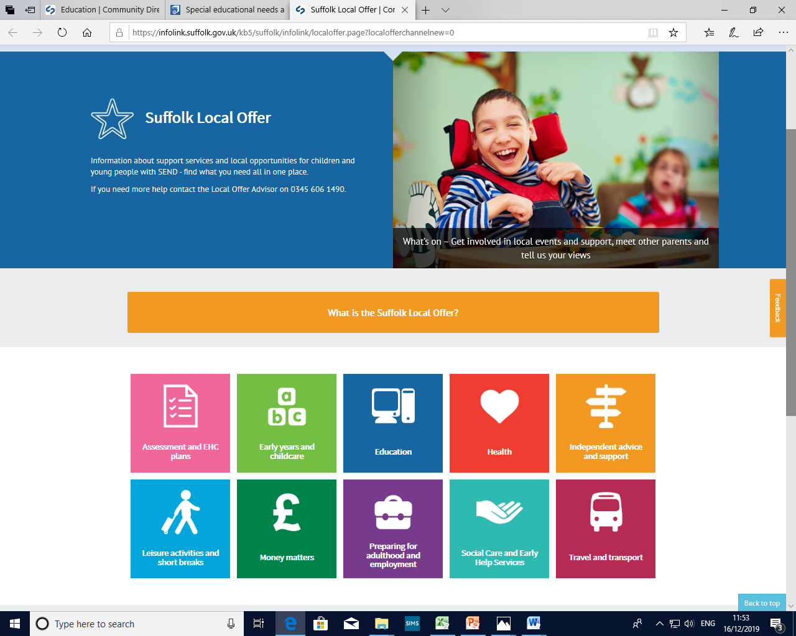
Click on the picture to access the Suffolk Local Offer
Return to Menu

